Slide 1

CE889 MLP
Naveen Kumar Chandra
2003246

Slide 2

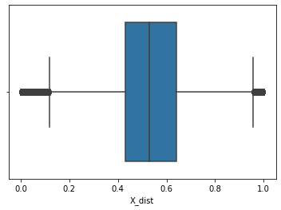
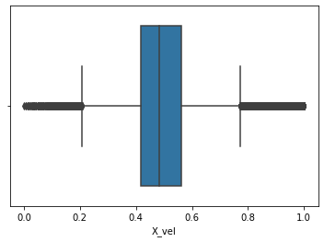
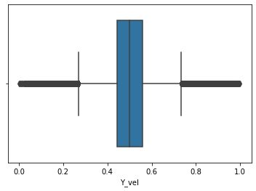
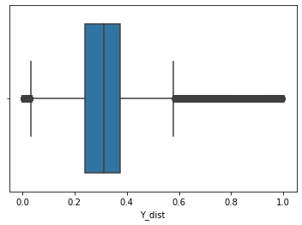
Data
108k entries
Data partition percentage 70% for training and 15% for validation and 15% for testing
Complete data is normalized between 0 & 1

Slide 3

Topology
→ Currently using 12 nodes in the hidden layer
Have bias nodes on the input layer as well as the hidden layer
The optimum number 12 was chosen by running multiple training runs and comparing the achieved validation error and game performance
The following topologies are tested
i) 2*4*2
ii) 2*8*2
iii) 2*10*2
iv) 2*12*2
v) 2*16*2
vi) 2*20*2

Slide 4
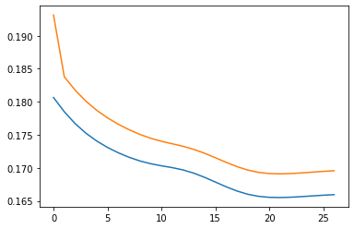
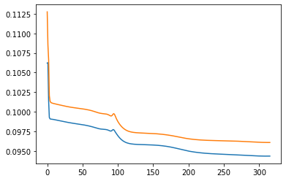
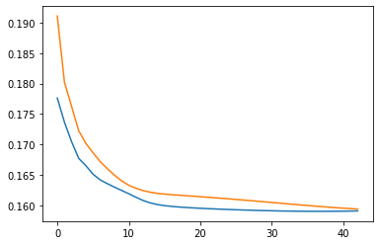
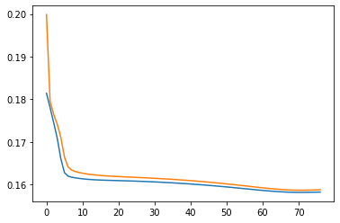
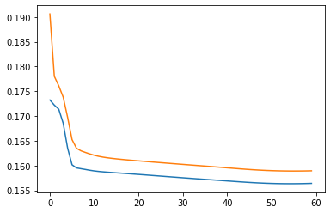
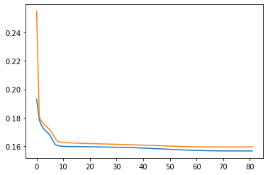
Results
4 Hidden nodes
12 Hidden nodes
The Observed Test Error is 0.16765236559292213
The Observed Test Error is 0.09721075333924661
8 Hidden nodes
16 Hidden nodes
The Observed Test Error is 0.09895892216165547
The Observed Test Error is 0.15626923598129316
10 Hidden nodes
20 Hidden nodes
The Observed Test Error is 0.15666843021529106
The Observed Test Error is 0.15829346487951693

Slide 5
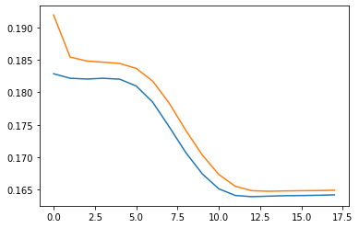
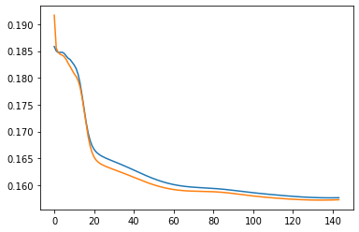
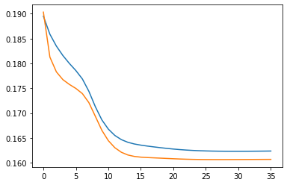
Parameters:
Currently using the following parameters
Lambda : 0.9
Learning rate : 0.9
Momentum : 0.1
No of Hidden Nodes: 4
Lambda value = 0.6
Learning Rate = 0.6
Momentum = 0.5
No of Hidden Nodes: 4
Lambda value = 0.6
Learning Rate = 0.9
Momentum = 0.2
The Observed Test Error is 0.16230166820949052
The Observed Test Error is 0.1581724868773636
No of Hidden Nodes: 10
Lambda value = 0.6
Learning Rate = 0.9
Momentum = 0.25
No of Hidden Nodes: 10
Lambda value = 0.9
Learning Rate = 0.9
Momentum = 0.1
The Observed Test Error is 0.1648231185626461
The Observed Test Error is 0.15666843021529106

Slide 6
RMSE
The best RMSE observed over test is 0.09721665104236658
The 342 epoch train error is 0.09693428124554547
The 342 epoch validation error is 0.09721075333924661
Early Stopping
Comparing validation error after each epoch run to determine incremental trend
If Error kept on increasing for five straight epochs then the model will stop training and re assign the weights of the least validation error observed epoch and moves on to testing the trained model against test data set

Slide 7
THANK YOU

